Slide 1
Containers and Modern DevOps
Nick Kwiatkowski, MMCFUG
11/14/23

Slide 2
Agenda
What are containers?
A picture of a modern DevOps pipeline
Developer workflow using containers
Moving apps from Dev to Test to Production in your own DC
Moving apps from Dev to Test to Production in the public cloud

Slide 3
Follow Along!
Install Git and Docker Desktop
Clone the repository at: https://github.com/quetwo/cfug-docker-project.git
We will be using the Docker Hub repository at: quetwo/cfug-docker-project:LATEST

Slide 4
What are containers?

Slide 5
Introduction to Containers
Containers are essentially portable, virtual machines built on layers of software used to stand up services.
They are designed to run single-purpose, small applications.
Containers make it easy for developers to build these images and script the movement of code from dev to test to production, regardless of where those are.
Multiple containers are grouped together to form your application.

Slide 6
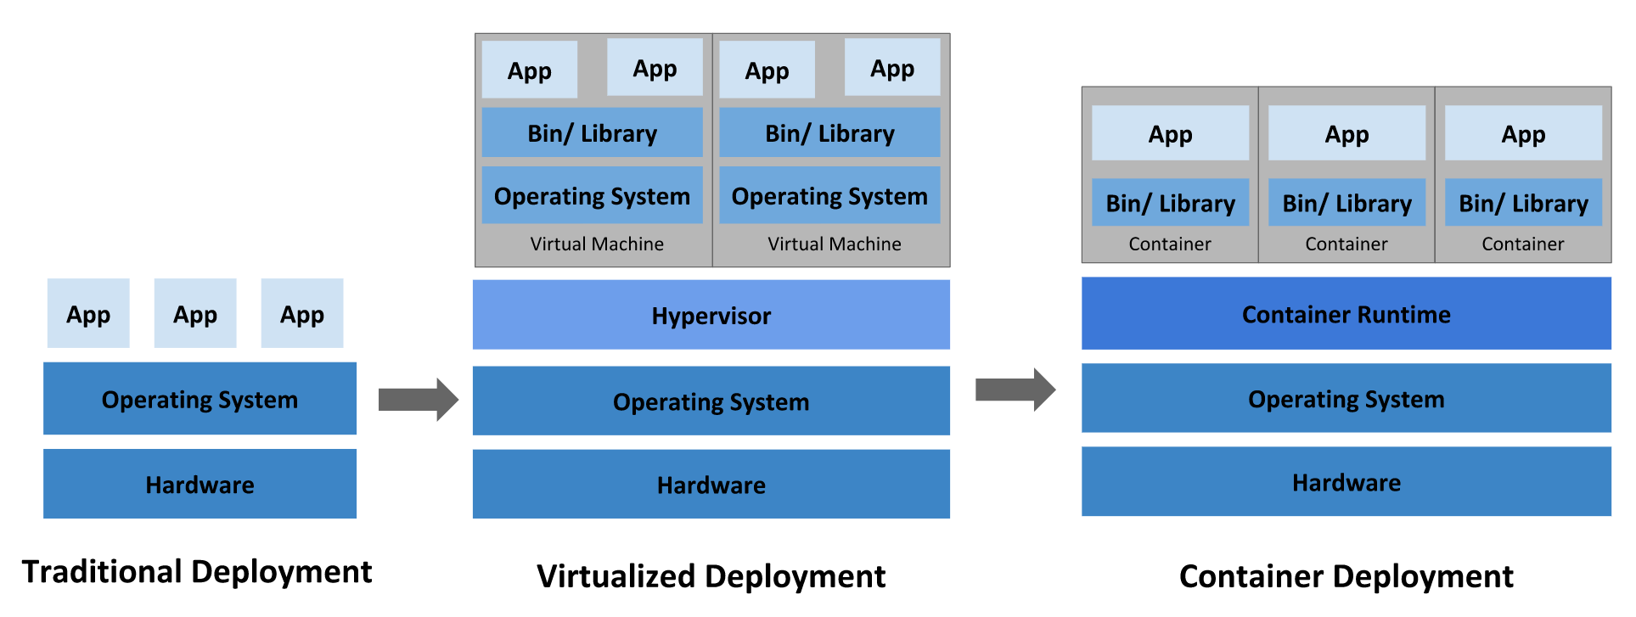
Introduction to Containers

Slide 7
Introduction to Containers
Containers are themselves built on “Images” and Images are built on Layers.
Layers are reusable snapshots of a hard drive that, when combined build your image that is used to run the container.
The base image, usually the kernel of your operating system would be either a Linux base or Windows. From there you would add in all the things to run your solution.
E.g. Linux Base + Java + Tomcat + Lucee.
There is no limit to the number of layers to build your solution.

Slide 8
Introduction to Containers
Linux Kernel
Base Operating System (Ubuntu)
Java JDK
Tomcat
Lucee Runtimes
Each of these layers are serialized and have a version associated with them.
When folks publish a new version, they tag that new version and make it available for folks upstream.
The combination of all these layers becomes the final image (also with a version number)

Slide 9
Introduction to Containers
A container is a ‘virtual machine’ that runs the hard drive image.
You can have multiple containers running that same image. These containers are their own ‘machines’ running. When they shut down, they revert back to content that was in their image.
This means that when we move to containers, our apps need to be configured in a way that any changes made to the filesystem can be lost on a regular basis.
Settings, uploaded files, etc., need to be made portable.

Slide 10
Introduction to Containers
containerd
Kubernetes
AWS EKS
GCP Container Services
Docker
Docker Swarm
Fargate
Azure Container Services
AWS ECS Fargate
VMWare Tanzu
RedHat OpenShift
One nice thing about the modern container space is that just about every vendor out there is making their systems compatible with containerd images.
This means that if you build an image in Docker, it will be compatible with everything that uses Kubernetes, Fargate, Azure, Tanzu, etc.
Only thing to note is that there are ‘exotic’ kernels that are not globally compatible, including the Windows and MacOS kernels. This means apps written on top of those images may not work everywhere.

Slide 11
Introduction to Containers
When working with containers there are usually two files that define how everything comes together:
Dockerfile
This is a file that acts as a script to build your images.
It can import other Dockerfiles, including public ones, to build your application.
Each line in this file generates that layer, or hard drive image.
Compose or Service definition file
This is a file that defines everything for the application you are standing up, including which images to use, environment variables, networking requirements, CPU requirements, memory, and application dependencies.
A service definition will usually tie together multiple running containers and set them up so your app can run. This can include your Lucee app, a database, a web server, etc.

Slide 12
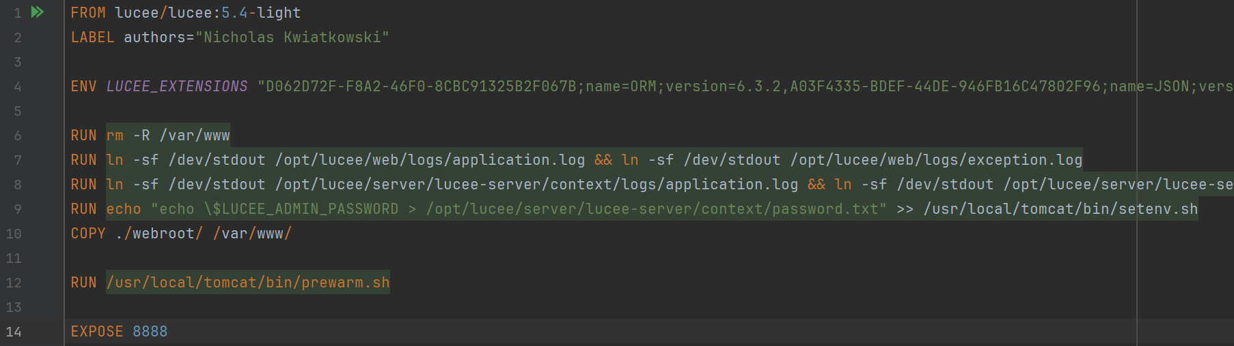
Introduction to Containers
Dockerfile
The Dockerfile is a text document that is a list of the commands executed in your image in order to setup your image.
The “FROM” line essentially imports a Dockerfile from somewhere else. This could be a URL, or it could be from hub.docker.com (default)
After the URL, you will see a colon, then a version number.
It’s typical to have versions as “latest” and major versions. You can include that so that if the upstream layers get updated or patched, you get those updates every time you launch your container.

Slide 13
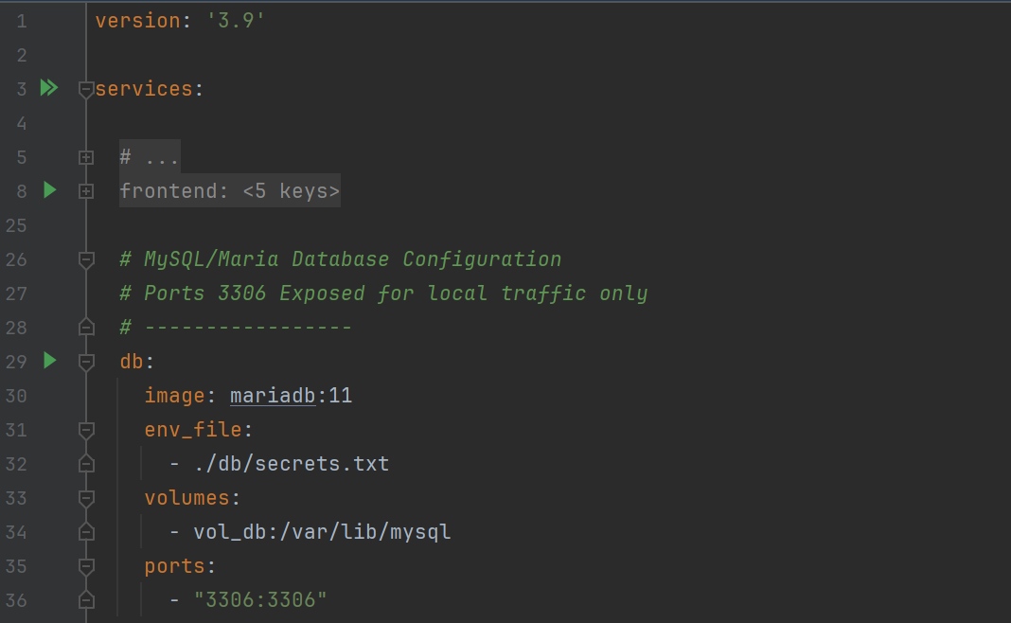
Introduction to Containers
Compose or service definitions
In Docker/Swarm, commonly used for dev machines, you would use Docker Compose (docker-compose.yml).
This file can define everything you need to run your app on a local machine.
You would include environment variables, paths to images, volumes (persistent storage), and which TCP/UDP ports you plan on exposing to your local machine.
Providers other than Docker use other file standards to setup their service definitions. We will demo others later.

Slide 14
Developer Workflow

Slide 15
Developer Workflow
From a developer perspective, you will want to work on your application and prepare it to be deployed into different environments (like production or test).
Most developers will use Docker (via Docker Desktop) to work on their code.
Docker allows you to bridge (or mount) the container and your local file system
This allows you to work on files, save them and have them show up in the container running on your desktop.

Slide 16
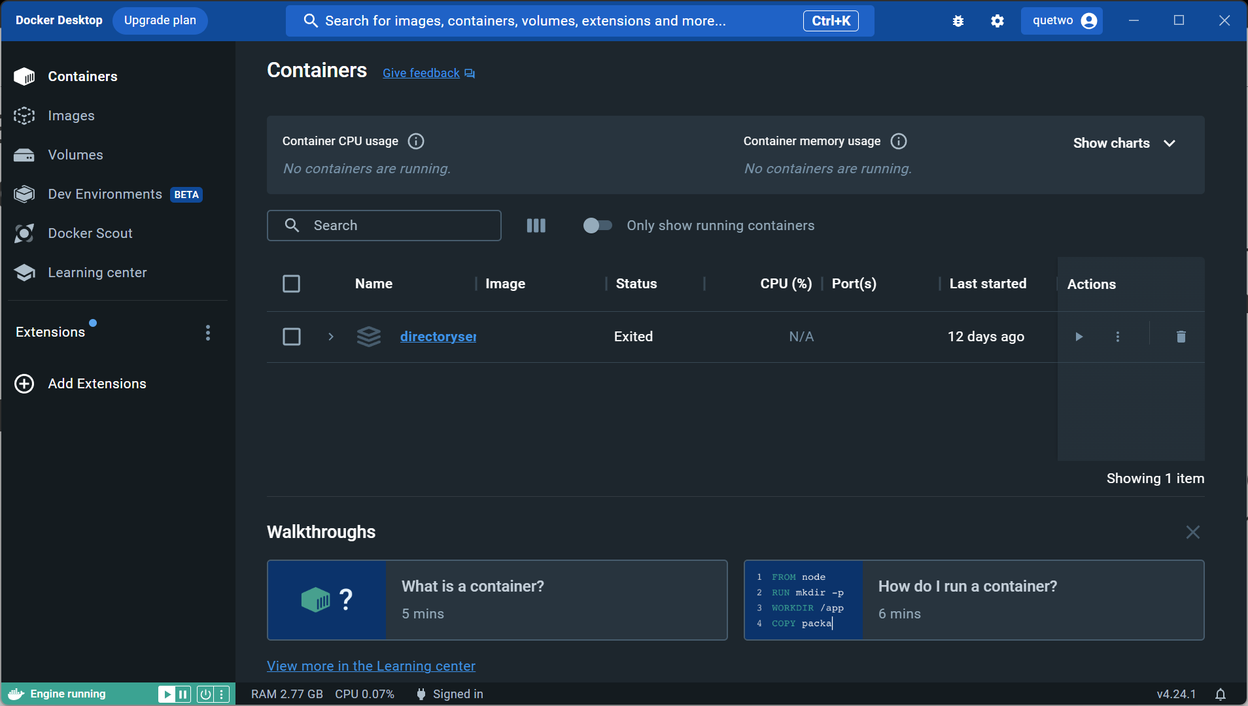
Developer Workflow
As a developer, you will need:
GIT (or another source control system)
This is extremely important, even if you only develop code by yourself. What ends up in the source control is what is deployed to the production server, and nothing else.
This makes deployments consistent and reliable
Docker Desktop
This is your container engine. On Windows it spins up an instance under WSL2 (Windows Subsystem for Linux), and on MacOS is uses containerd to deploy containers.
Easy to start, stop, deploy, clean up images, volumes and containers.

Slide 17
Developer Workflow
Setting up your environment
Install Docker Desktop, Git
Create a git repository
Setup a directory structure for your project
One directory per container you plan on running. E.g. frontend/, db/, proxy, etc.
Create base Dockerfile(s) for your containers
Create a base docker-compose.yml for your project
Run docker compose up in a new terminal
Write your code!

Slide 18
Developer Workflow
Coding:
If you need to restart your server you can either
docker compose down -> docker compose up
docker compose restart <container> e.g. docker compose restart frontend
Logs should be shown to the terminal window. Smarter IDEs will also connect with it as well
If you need to make changes to the docker compose or Dockerfile, you will need to restart with docker compose down / docker compose up.
When there aren’t any docker containers running, there shouldn’t be any impact on the performance or memory on your PC.

Slide 19
Developer Workflow
Getting ready to push to test/prod:
If the app pipeline is setup correctly, all you should have to do is commit to git.
If you are pushing to GitHub, you can use GitHub actions to run tests, automatically build your images, etc.
If you don’t use GitHub or other central repo that has a CI/CD pipeline available you might need to build your code on your PC.
docker compose build docker compose push
These commands will package up your code and push them to your image repository (more on that in a few slides)

Slide 20
Developer Workflow
Notes about building your apps:
Every time you deploy a new container (or do upgrades, etc)., the disk will be restored to what is in the image.
Known as empericial disks.
If you allow uploads, for example – you will need to design a strategy to store those outside your image.
You will want to do as much declaration in code instead of an admin panel.
If your workflow forces you to futz with the CFIDE/Lucee Admin, you will want to figure out how to do that in code.
Utilize environment variables and secrets as much as you can!
All container environments allow you to utilize environment variables to make the images portable and agile. E.g. database DSNs, API endpoints, etc.

Slide 21
DevOps Workflow

Slide 22
DevOps Workflow
Once you have an image you want to publish somewhere (like test or prod), you will want to build your “CI” workflow.
Application Code
Source Code Repository
Build Service
Image Repository
Container Server

Slide 23
DevOps Workflow
Build Process
You will want to build your own images and ‘publish’ them somewhere so that your container servers can access them.
Free image hosting service : hub.docker.com is the default service.
You can also host images on GitLab, Bitbucket, , or a variety of other services.
Note: Services that require authentication are not always compatible with all container services.
Two ways to get images built
Use an automation service/script like GitHub Actions / GitLab Pipelines
Images would get built when you push new code, or when you mark as release, etc.
Build images yourself and push

Slide 24
DevOps Workflow
Build Process
Using automation, GitHub Actions can check-out the code in the repository launch a small build server, and build your image.
You will need to setup an account and landing place on your image repository.
All you need to do is provide the .github/actions/release.yml. Then create a release in GitHub and watch the action do the process.
On your local machine, you will need to execute a few commands
You will need to setup an account and landing place on your image repository.
Update the docker compose file with your image location.
Do the docker compose build then docker compose push commands to push the image to the repository. Verify on the repository that the image push was successful. Watch for tags – these are the version numbers you will use when using the service.

Slide 25
DevOps Workflow
Container Services:
For on-prem, there are a few options:
Docker Engine / Docker Stack –
Easy to setup, same commands as your developer build. Install a base Linux server (I recommend Rocky Linux, but any should work), and install docker-engine.
Use Docker Compose files to manage your deployments
Kubernetes
Command line setup on Linux. You will need a “master server” and then pods.
You will upload a service definition file (similar to a docker compose, but many more options)
You will also need to setup networking, proxies, etc.
RedHat OpenShift or VMWare Tanzu
You will need to setup PC configurations, RAM, Networking, CPUs, etc. There is a GUI to get these things going similar to the cloud providers.

Slide 26
DevOps Workflow
Container Services
For Cloud Based, there are a /ton/ of options
Generally, they all work the same under the hood… You will point them to a repository image, set your compute resources, and then environment variables.
Do note, many of the cloud based services require a proxy/load balancer in order to launch your apps in production.

Slide 27
Demo of launching the app in the cloud

Slide 28
Q&A

Slide 29
Thanks!

